Slide 1

Borewell wATER ANALYSIS
AND
MOTOR TEMPERATURE DETECTION
Ministry Category: Ministry of Coal Problem Code: #MOC1 Team ID: 11752 Team Leader Name: Shinjanee Gupta

Slide 2

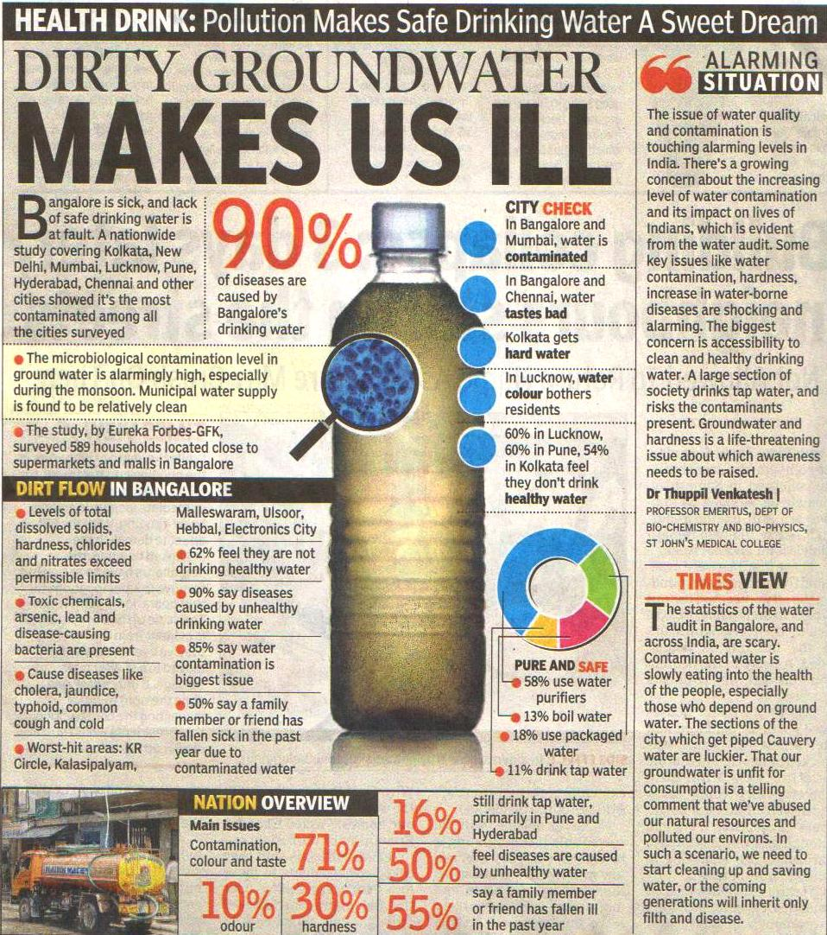
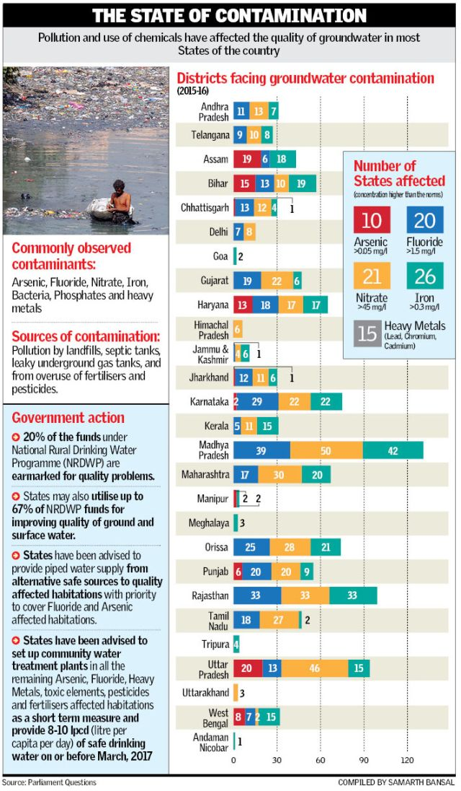

Slide 3
PROBLEM STATEMENT
A suitable IT solution to be developed to measure water quality and motor temperature in bore wells using sensors. A centralized alerting system to be developed.
Why do we need it?
1) The quality of groundwater affects not only our health, but also
society and the economy.
2) Groundwater contamination adversely affects property values, economic development, and the overall quality of life we all share.
3) The motor also needs to be maintained to avoid the damage due to overheating and dry run condition.
4) Hence it is the responsibility of the well owner to ensure a safe drinking water supply and to take immediate actions whenever required.

Slide 4
CONTENTS
Current scenario
Solution
Solution flow chart
Hardware and software requirement
Implementation
Analysis
Applications
Cost of the Solution

Slide 5
CURRENT SCENARIO
Existing system mechanisms consist of semi-automated or manually controlled devices . These mechanisms provide information neither accurately nor timely.
These conventional methods are labor intensive, time consuming and costly. A cost effective and reliable system needs to be developed.
The values determined by the conventional methods might be inaccurate and these are not recorded uniformly from time to time, thereby making the water quality analysis difficult.
Our water quality measurement approach makes use of the technologies which is quite efficient, uniform and progressive. Moreover, it is designed to be really scalable and user friendly.

Slide 6
Solution
A centralized alerting system is developed as a solution which measures water quality from different borewells and sends the data on cloud.
Motor temperature and dry run conditions are checked continuously and motor will be switched OFF automatically when values cross threshold.
Notifications will be sent to the concerned authority on his/her mobile app to take immediate actions.
Graphical analysis is also made available to the user on the webpage.
An alert message could be sent to the concerned authority via GSM.

Slide 7
APPROACH
1.Sensors will measure the corresponding values of water.
2. Digital signals given to NodeMCU.
3. Node MCU will send the measured value to the cloud server on thingspeak.
4. The sensor values are then fetched from the cloud by the app developed.
5. The app will show notifications according to the variations in measured values.

Slide 8
PARAMETERS OF WATER MEASURED
Motor temperature- The temperature of motor is measured to avoid dry run and overheating conditions.
Water temperature- Temperature has an important influence on water. High water temperatures can increase the solubility and thus toxicity of certain compounds.
pH-measure of the acidity or basicity of an aqueous solution
Turbidity-Turbidity is the measure of water clarity.There are suspended particles that are present in the water. These particles decrease the passage of light through the water
Water level-measures the depth of water.

Slide 9

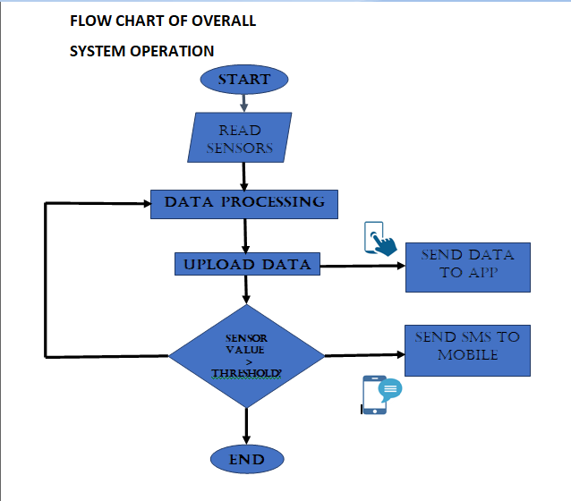

Slide 10
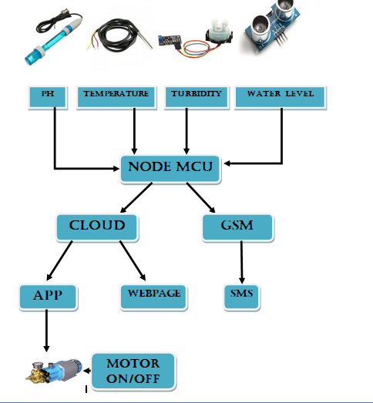

Slide 11
Hardware & software requirements
The hardware and software requirements of the project are as follows:
Sensors- The sensors of pH, turbidity, temperature and water level are used to measure different parameters of water quality.
Development Module(NodeMCU)-It is the ESP8266 WiFi module and a self contained SoC with integrated TCP/IP protocol stack that give any microcontroller access to the WiFi network.
Actuator- An electro-mechanical device for controlling the motor of borewell. It is used to turn the motor ON or OFF using the instructions from the app.
Communication modules - For transmitting water quality related information.

Slide 12
COMMUNICATION MODULES
WiFi-
Stands for Wireless Fidelity. Provides high speed internet connection and network connection without any use of cables.
GSM-
Stands for Global System for Mobile communication. It is an open, digital cellular technology used for transmitting mobile voice and data services. It is used here to send the information related to water quality parameters via SMS to the mobile.

Slide 13
SENSORS USED
pH Sensor | pH sensor is used to measure the pH of water of the bore well and send the value to the concerned authority. SEN0161 DFROBOT pH sensor
Turbidity Sensor | Turbidity sensor is used to measure the turbidity of the water. The sand content of the water can be measured using this sensor. Turbidity sensor used is SKU: SEN0189. It measures the turbidity by measuring the amount of light scattered at 90 degree.
Water Level Sensor | Water level sensor is used to measure the level of water. The different levels indicate the depth of water. Ultrasonic sensor used is HC - SR04. Sensors measure their level against a pre-set reference.
Temperature Sensor | Temperature sensor is used to measure the temperature of motor used in a borewell. DS18B20 sensor is used. If the temperature gets higher than the threshold value, a notification is shown. Used in measuring water temperature(waterproof version) and motor temperature.

Slide 14
IMPLEMENTATION
The project includes four software implementations:
CLOUD: A cloud server is used to store and retrieve data. It is used in the following way.Different Channels are created through which data is sent to the cloud and can be retrieved through read API keys
APP: When an option is selected, the app will fetch data from the cloud. It will provide the most recently data values along with the graph of the particular parameter.
WEB PAGE:Web page provides log of data on the channel. It can be used to view sensor values in tabular format for different locations and Graphs of sensor values for different locations
GSM: In absence of internet, The GSM module will send message to the user, giving the description of the sensor values of the parameters which have crossed the threshold.

Slide 15
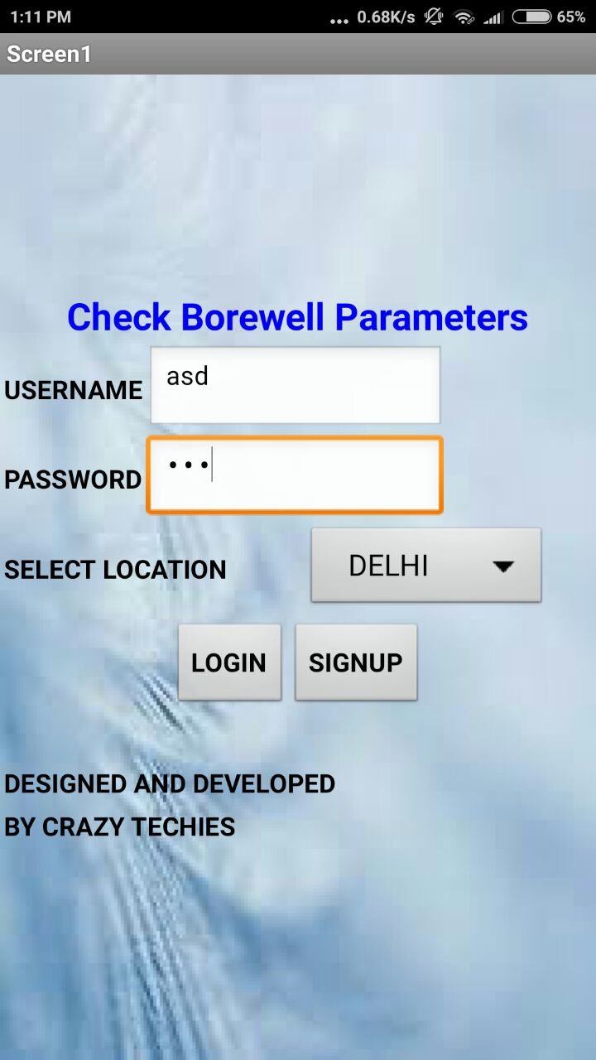
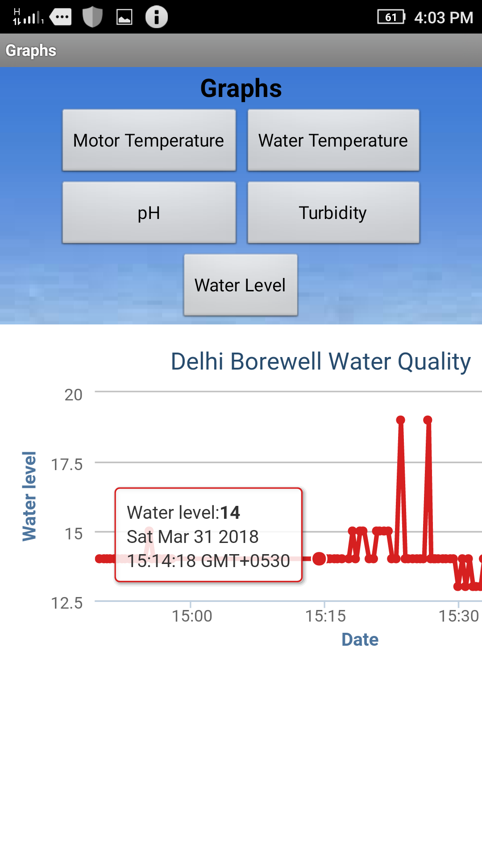
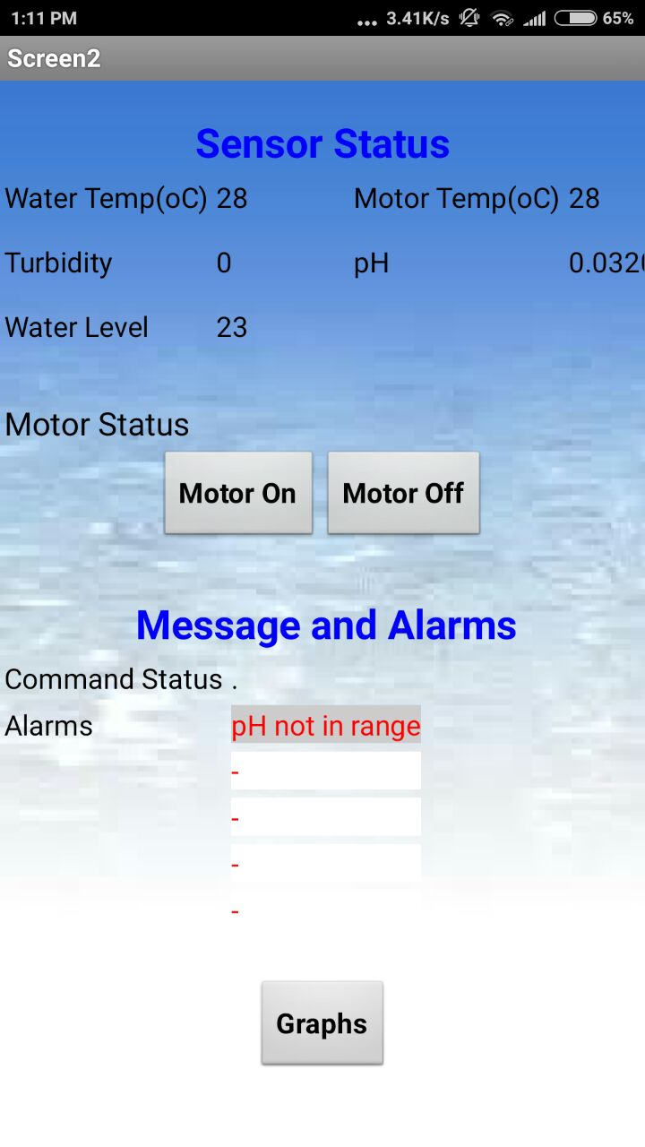
APP

Slide 16
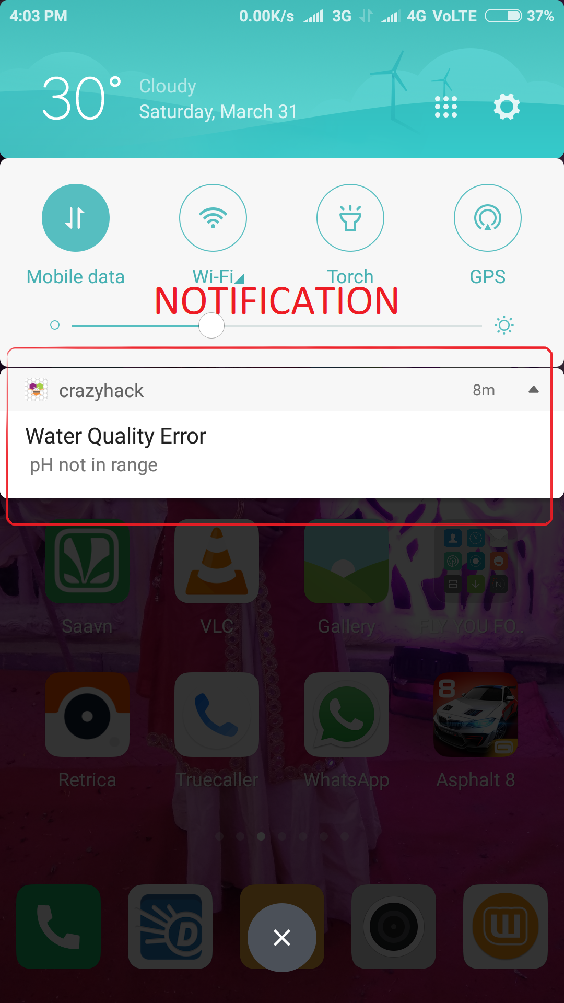
APP notification

Slide 17
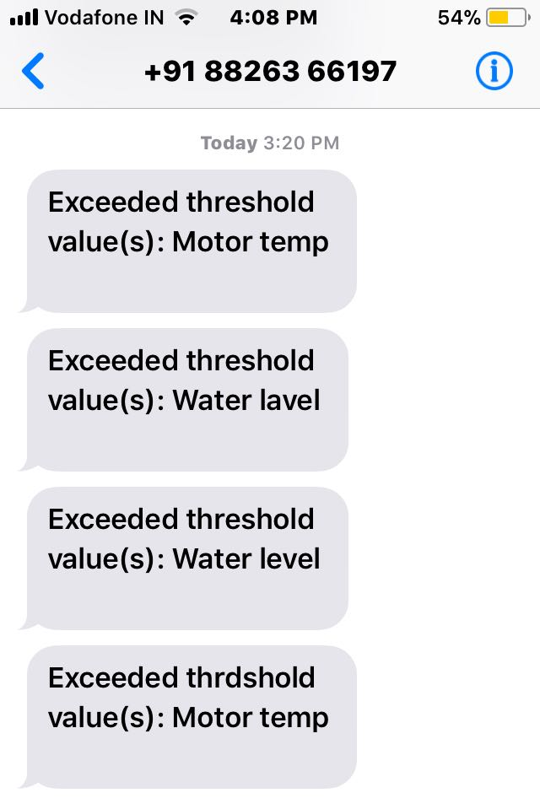
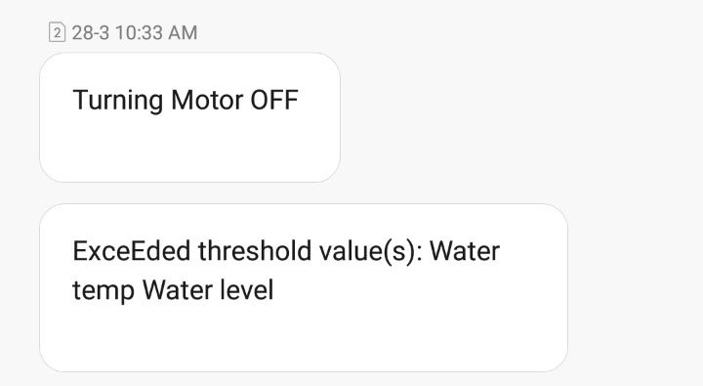
GSM

Slide 18
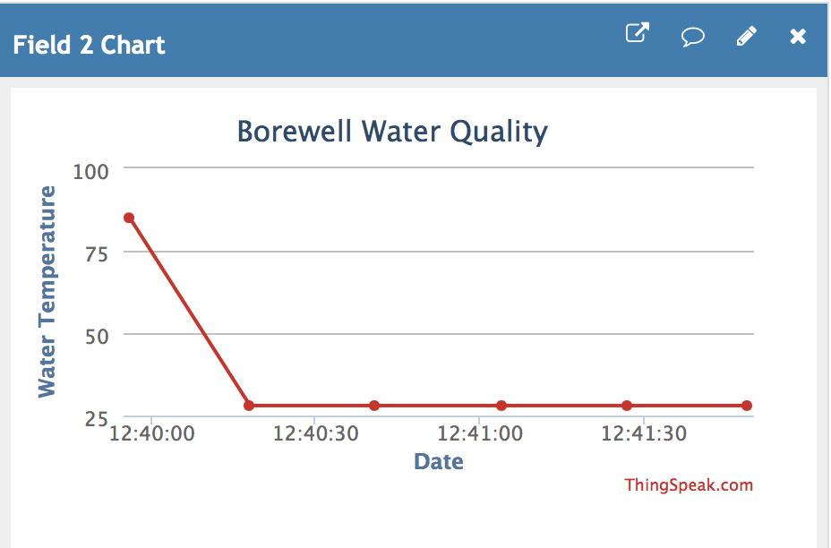
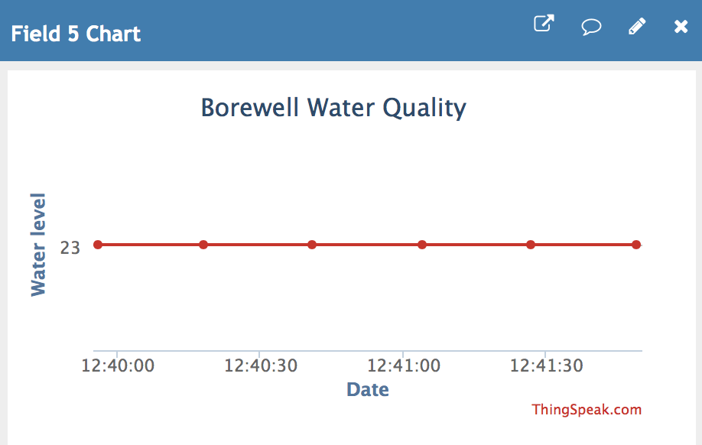
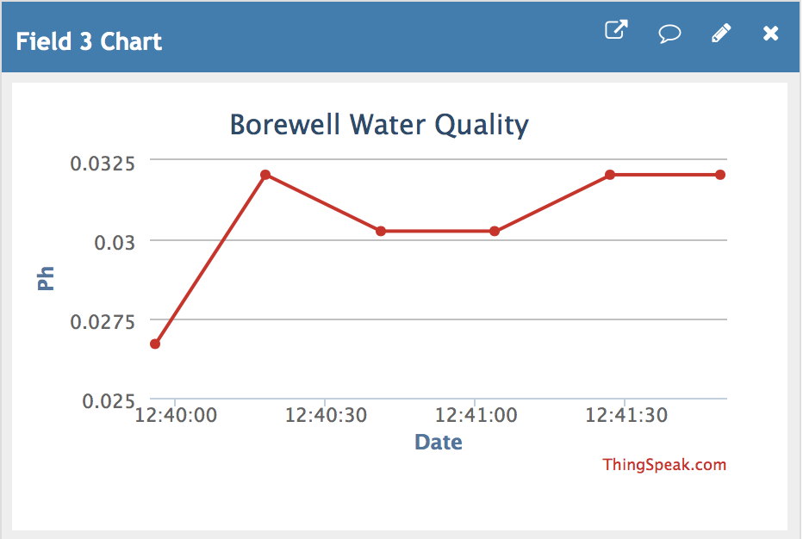
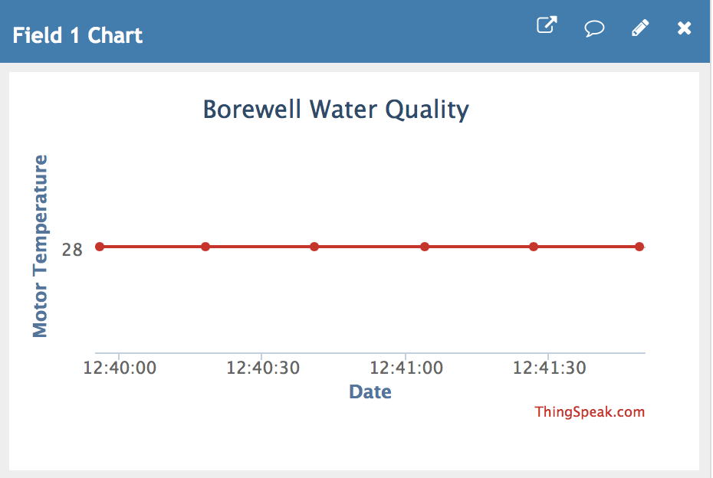
ANALYSIS

Slide 19
APPlications
Efficient for borewells both in urban as well as remote areas.
One can develop a Portable water monitoring system using this solution.
Can be used for water monitoring for both irrigation and other purposes.

Slide 20
Total Cost of Implementation
Device | Amount in Rs.
pH Sensor | 1800/-
Turbidity Sensor | 1000/-
Motor Temperature Sensor | 75/-
Water Temperature Sensor | 150/-
Water Level Ultrasonic Sensor | 110/-
NodeMCU | 300/-
Motor | 50/-
Total | 3485/-

Slide 21
THANK YOU

